Slide 1
Introduction to HACCP systems

Slide 2
How to use this presentation
Click on the “Slide show” tab and select “Play from current slide”

Slide 3
How to use the presentation
The slides are narrated by Dr Andy Bowles from ABC Food Law.
Please ensure that you have the sound turned up on your computer!

Slide 4
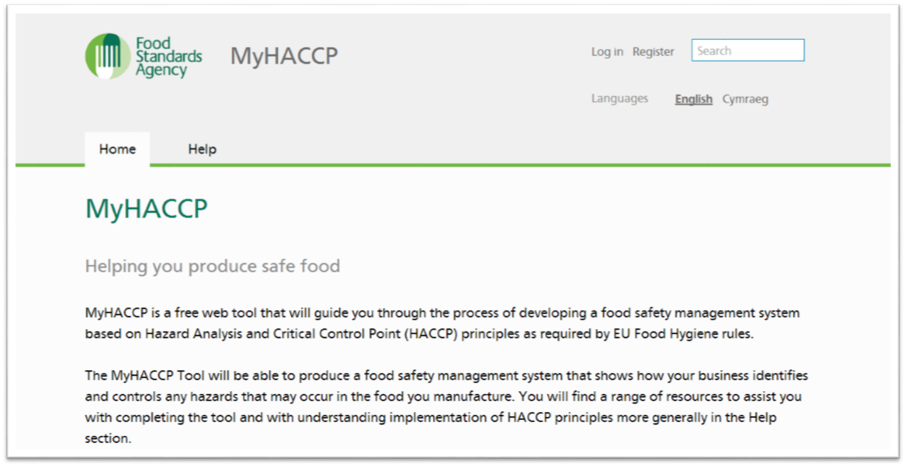
MyHACCP
This presentation has been designed to help you complete the MyHACCP online tool.

Slide 5
Aims of this presentation
To provide users of the MyHACCP online tool with some background information on HACCP systems.

Slide 6
The programme
This presentation is divided into the following sections:
Introduction to HACCP systems
Preparing for a HACCP
The Seven Principles of HACCP

Slide 7
Section 1: Introduction to HACCP systems

Slide 8
Section 1: Introduction to HACCP systems
Here we are going to discuss:
What is HACCP?
The History of HACCP.
HACCP and the law.
Key definitions.
Principles of HACCP.

Slide 9
What is HACCP?
HACCP is an acronym for:
Hazard
Analysis
Critical
Control
Point
HACCP is a food safety risk assessment

Slide 10
History of HACCP
HACCP was first developed in the 1960’s to assure safe food for astronauts involved in the United States space programme.

Slide 11
History of HACCP
Since the 1960’s, HACCP has received international recognition.
Codex Alimentarius Commission
HACCP System and Guidelines for its Application
CAC/RCP-1 (1969), Rev 4 (2003)

Slide 12
HACCP and the law
There is a legal requirement for food businesses to implement:
“Systems Based on HACCP Principles”
Article 5(1) Regulation (EC) 852/2004

Slide 13
Introduction to HACCP
Some definitions:
Hazard: Potential to cause harm.
Risk: Probability of a hazard actually happening.
Control measure: something that will prevent or eliminate a hazard or reduce it to an acceptable level
Critical control point: a step where the control measure is essential for food safety.

Slide 14
Introduction to HACCP
There are seven steps or “principles of HACCP”
Conduct a Hazard Analysis
Determine the Critical Control Points
Establish Critical Limits
Establish monitoring procedures
Establish corrective actions
Establish verification procedures
Establish record keeping and documentation

Slide 15
Section 2: Preparing a HACCP

Slide 16
Section 2: Preparing a HACCP
Here we are going to discuss:
Pre-requisites to HACCP
First steps in preparing a HACCP

Slide 17
Pre-requisites to HACCP.
Before starting a HACCP study you should consider the “pre-requisites”.
Pre-requisites provide the basic environment & operating conditions and are essential for a successful HACCP.
Prerequisites can be based on:
Legal requirements
Good Hygiene Practice
Good Manufacturing Practice
Codex Alimentarius General Principles

Slide 18
Examples of pre-requisites
Pre-requisite issues include:
Layout and design of food premises
Structure and condition of food premises
Food allergen control
Supplier control
Storage and transport
Equipment
Personal hygiene
Temperature control
Training
Cleaning
Pest control
Waste control
Product withdrawal

Slide 19
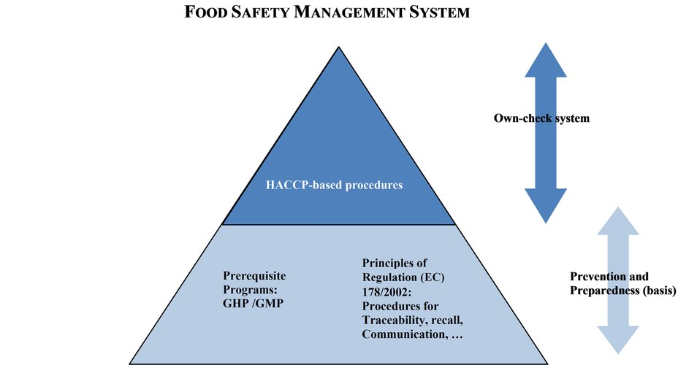
Pre-requisite programmes (PRPs)
Relationship between PRP and HACCP
Source: Commission Notice (2016/C 278/01) on the implementation of food safety management systems covering prerequisite programs (PRPs) and procedures based on the HACCP principles, including the facilitation/flexibility of the implementation in certain food businesses

Slide 20
Operational Prerequisite Programmes(OPRPs)
Pre-requisites that are essential to food safety.
For example disinfection forms part of a PRP.
Where disinfection of equipment
Essential to food safety and;
Hazard not removed by a subsequent step.
This will be an OPRP.

Slide 21
Preparing a HACCP – First Steps

Slide 22
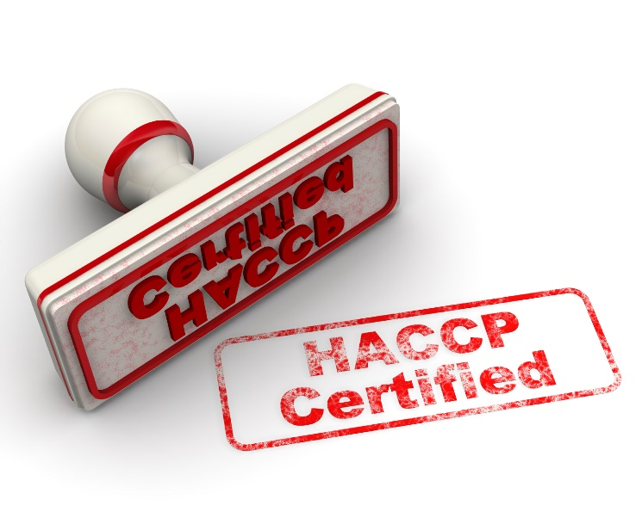
The Seven Principles of HACCP

Slide 23
Codex seven principles
Conduct a Hazard Analysis
Determine the Critical Control Points
Establish Critical Limits
Establish monitoring procedures
Establish corrective actions
Establish verification procedures
Establish record keeping and documentation

Slide 24
Principle 1 Conduct a Hazard Analysis

Slide 25
Principle 1
Conduct a Hazard Analysis
Two stage process:
Identify significant hazards that are:
Reasonably likely to occur
Likely to cause illness/injury if not controlled
Identify appropriate control measures for each significant hazard.

Slide 26
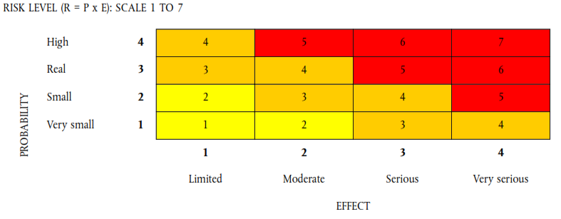
Principle 1: In practice
Evaluation of hazards
Hazards are quantified in terms of:
Severity (Effect)
Likely occurrence (Probabiity)

Slide 27
Principle 1: In practice
All significant hazards should have been identified
Controls identified for each of these hazards

Slide 28
Principle 2
Determine Critical Control Points (CCPs)
CCP = Step where:
Control can be applied and is
Essential to prevent, eliminate or reduce hazard to an acceptable level.
Correct identification of CCPs essential
Decision trees can be used.

Slide 29
Simplified decision tree

Slide 30
Logical approach required:
Decision trees often used (but not essential)
Example of a decision tree

Slide 31
Principle 3
Establish Critical Limits
Critical limits separate acceptability from unacceptability.
Max/min values at which a parameter must be controlled at a CCP to control hazard.
Critical limits can be based on:
pH
Water activity aw
Temperature
Time etc

Slide 32
Principle 4
Establish Monitoring Procedures
Planned sequence of:
Observations
Measurements
Effective monitoring involves trend analysis
Intervention before loss of control occurs

Slide 33
Principle 4
Monitoring of controls:
Only required at critical points
Frequency depends on:
Nature of product ie uniform size
Nature of process ie automated/manual
Nature of production ie batch size
History of previous checks

Slide 34
Principle 5
Establish Corrective Actions
Essential when deviation from critical limits occurs
HACCP plan should identify:
Action required when deviation occurs
Including investigation of cause
Who is responsible for implementing corrective action
What records should be made

Slide 35
Principle 6
Establish Verification Procedures
Checks that HACCP is fit for purpose
Validation
Ensure that all controls are scientifically sound
Verification that system works as expected.
Calibration details
Additional verification (Review) required:
For new products
where new hazards identified

Slide 36
Principle 7
Establish Documentation
Should include:
Summary of hazard analysis
Rationale in hazard identification
HACCP team/responsibilities
Description of food, distribution etc
Verified flow diagram
HACCP plan diagram
Purpose of documentation
To ensure effective implementation

Slide 37
Summary
HACCP is a food safety management system
Prerequisites are essential
Careful preparation of HACCP necessary
HACCP involves seven steps(principles)
Conduct hazard analysis
Identify Critical Control Points
Establish Critical Limits
Establish monitoring procedures
Establish corrective actions
Establish verification procedures
Establish documentation
MyHACCP is a tool to help you achieve the above.

